Slide 1
GPIO
Character Driver

Slide 2
CONTENTS
GPIO subsystem & API's.
Interrupt using gpio.
Usage of Procfs in Driver.
Usage of Sysfs in Driver.
Baremetal GPIO handling on Raspberry pi 3b+ board.
Kernel Timers.

Slide 3
What is GPIO?​
GPIO or General-Purpose Input Output is one of the most frequent terms which you might have come across with. A GPIO is a signal pin on an integrated circuit or board that can be used to perform digital input or output functions. The GPIO behavior (input or output) is controlled at the run time by the application software/firmware by setting a few registers. Typical applications include reading/writing values from/to analog or digital sensors/devices, driving a led, driving a clock for I2C communication, Generating triggers for external components, Issuing Interrupts, etc. ​
All the microcontrollers will be having a few registers to control the gpio functions. Those register names will vary based on the microcontroller.`
​
What is the GPIO port?​
There will be many GPIO pins in the microcontroller. Those pins are grouped by some name. So, that one group is called GPIO port. Simply, the collection of GPIOs is called GPIO port. For example, If you take the STM32 microcontroller, it has 5 GPIO ports (PORT A, PORT B, PORT C, PORT D, PORT E). Each port has 16 GPIO pins. Like this, other microcontrollers will have few GPIO ports.

Slide 4
How to access GPIO in Linux kernel
If anyone wants to access the GPIO from the Kernel GPIO subsystem, they have to follow the below steps.
Verify whether the GPIO is valid or not.
If it is valid, then you can request the GPIO from the Kernel GPIO subsystem.
Export the GPIO to sysfs (This is optional).
Set the direction of the GPIO
Make the GPIO to High/Low if it is set as an output pin.
Set the debounce-interval and read the state if it is set as an input pin. You enable IRQ also for edge/level triggered.
Then release the GPIO while exiting the driver or once you are done.

Slide 5
Validate the GPIO:
Before using the GPIO, we must check whether the GPIO that we are planning to use is valid or not. To do that we have to use the below API.
bool gpio_is_valid(int gpio_number);
gpio_number : GPIO that you are planning to use
It returns false if it is not valid otherwise, it returns true.
This API determines whether the GPIO number is valid or not. Sometimes this call will return false even if you send a valid number. Because that GPIO pin might be temporarily unused on a given board.

Slide 6
Request the GPIO
Once you have validated the GPIO, then you can request the GPIO using the below APIs.
int gpio_request(unsigned gpio, const char *label);
gpio : GPIO that you are planning to use.
label : label used by the kernel for the GPIO in sysfs. You can provide any string that can be seen in cat /sys/kernel/debug/gpio. You can see the GPIO assigned to the particular GPIO.
It returns 0 in success and a negative number in failure.
.There are other variants also available. You can use any one of them based on your need.
int gpio_request_one(unsigned gpio, unsigned long flags, const char *label); – Request one GPIO.
int gpio_request_array(struct gpio *array, size_t num); – Request multiple GPIOs.

Slide 7
Export the GPIO
For debugging purposes, you can export the gpio which is allocated using the gpio_request()to the sysfs using the below API
int gpio_export(unsigned int gpio, bool direction_may_change);
gpio : GPIO that you want to export.
direction_may_change : This parameter controls whether user space is allowed to change the direction of the GPIO.
true – Can change, false – Can’t change.
Returns zero on success, else an error.
Unexport the GPIO
If you have exported the GPIO using the gpio_export(), then you can unexport this using the below API.
void gpio_unexport(unsigned int gpio);
gpio : GPIO that you want to unexport

Slide 8
Set the direction of the GPIO
When you are working on the GPIOs, you have set the GPIO as output or input. The below APIs are used to achieve that.
This API is used to set the GPIO direction as input.
int gpio_direction_input(unsigned gpio);
gpio : GPIO that you want to set the direction as input.
Returns zero on success, else an error.
This API is used to set the GPIO direction as output.
int gpio_direction_output(unsigned gpio, int value);
gpio : GPIO that you want to set the direction as output.
value : The value of the GPIO once the output direction is effective.

Slide 9
Change the GPIO value:
Once you set the GPIO direction as an output, then you can use the below API to change the GPIO value.
gpio_set_value(unsigned int gpio, int value);
gpio : GPIO that you want to change the value.
value : value to set to the GPIO. 0 – Low, 1 – High.
Read the GPIO value
You can read the GPIO’s value using the below API.
int gpio_get_value(unsigned gpio);
gpio : GPIO that you want to read the value.
It returns the GPIO’s value. 0 or 1.

Slide 10
Release the GPIO:
Once you have done with the GPIO, then you can release the GPIO which you have allocated previously. The below API help in that case.
void gpio_free(unsigned int gpio);
gpio : GPIO that you want to release.
There are other variants also available. You can use any one of them based on your need.
void gpio_free_array(struct gpio *array, size_t num);
Release multiple GPIOs.

Slide 11
What is an interrupt?
An interrupt is a signal emitted by a device attached to a computer or from a Program within the computer. It requires the operating system to stop and figure out what to do next. An interrupt temporarily stops or terminates a service or a current process
Importance Of Interrupt In Character Driver
An interrupt is a hardware signal from a device to a CPU. It tells the CPU that the device needs attention, and that the CPU should stop performing what it is doing and respond to the device.

Slide 12
Get the IRQ number for the GPIO
int gpio_to_irq(unsigned gpio);
gpio: which gpio pin do you want select as an interrupt line.
How to Request IRQ
request_irq(unsigned int irq,irq_handler_t handler,unsigned long irqflags,
const char*devname,void*devid);
irq: Interrupt line to allocate
handler: Function to be called when the IRQ occurs
irqflags: interrupt type flags
devname: an ascii name for the claiming device
devid: a cookie passed back to the handler function
Interrupt Flags
IRQF_TRIGGER_RISING IRQF_TRIGGER_FALLING IRQF_TRIGGER_HIGH IRQF_TRIGGER_LOW

Slide 13
Set the debounce-interval
The below API is used for sets debounce time for a GPIO. raspberry pi is not supporting that. That’s why we have commented on that line in our source code. Instead, we used some software hack to eliminate multiple times IRQ being called for a single rising edge transition. You can remove the software hack and uncomment that gpio_set_debounce() if your microcontroller supports this.
int gpio_set_debounce(unsigned gpio, unsigned debounce);
gpio : GPIO that you want to set the debounce value.
Debounce: Delay of the debounce.
It returns 0 on success. otherwise, <0.

Slide 14
local_irq_save();
Defined in the include/linux/irqflags.h header file.
It saves the state of the IF flag of the eflags register and disables interrupts on the local processor.
local_irq_restore();
This macro defined in the same header file and does the opposite thing it restores the interrupt flag and enables interrupts.
IRQ_HANDLED
It is a MACRO which means that we did have a valid interrupt and handled it.

Slide 15
Hardware Required
Raspberry Pi
Breadboard
Resistor
LED
Push-button
Bring up Raspberry PI
Install Raspberry Pi OS (64-bit) with desktop in the SD card.
Then install the kernel header using sudo apt install raspberrypi-kernel-header

Slide 16
Accessing the input GPIO in Linux Kernel
Verify the GPIO is valid or not.
If it is valid, then you can request the GPIO from the Kernel GPIO subsystem.
Set the direction of the GPIO as an input
Set the debounce-interval
Read the GPIO.
You enable IRQ also for edge/level triggered if you need it.
Then release the GPIO while exiting the driver or once you are done

Slide 17
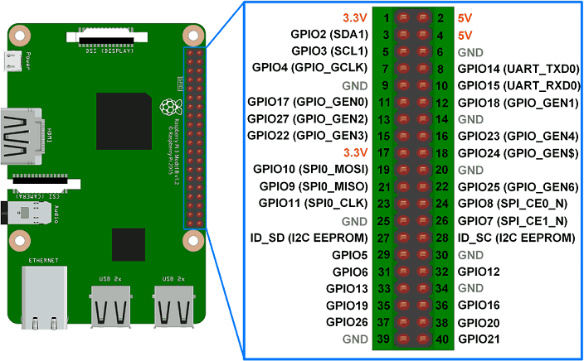
Raspberry pi Pin Diagram

Slide 18
Testing the Device Driver
Build the driver by using Makefile (sudo make)
Load the driver using sudo insmod driver.ko
Just press the Push button.
That output LED should be toggled

Slide 19
Disadvantages of interrupts
When interrupt is occurred, then cpu will suspend the current process execution and then process the interrupt .This may lead to increase the other process execution time when compared to actual time execution before interrupt occurred.
We need to take care of interrupt handler because improper usage of interrupt makes CPU to execute same code continuously if it is struck in endless loop.

Slide 20
Procfs in Linux
Introduction
Most of Linux users have at least heard of proc. Some of you may wonder why this folder is so important.
On the root, there is a folder titled “proc”.
This folder is not really on /dev/sda or wherever you think the folder resides. This folder is a mount point for the procfs (Process Filesystem) which is a filesystem in memory.
Many processes store information about themselves on this virtual filesystem.
Procfs also stores other system information.
proc files can also be used to control and modify kernel behavior on the fly. The proc files need to be writable in this case. but they are meant to retrieve info from kernel related process.

Slide 21
The proc file system is also very useful when we want to debug a kernel module. While debugging we might want to know the values of various variables in the module or maybe the data that the module is handling. In such situations, we can create a proc entry for ourselves and dump whatever data we want to look into in the entry.
Creating procfs directory:
You can create the directory under /proc/* using the below API.
struct proc_dir_entry *proc_mkdir(const char *name, struct proc_dir_entry *parent);
name: The name of the directory that will be created under /proc. parent: In case the folder needs to be created in a subfolder under /proc a pointer to the same is passed else it can be left as NULL.

Slide 22
Creating Process Entry: The creation of proc entries has undergone a considerable change in kernel version 3.10 and above. In this post, we will see one of the methods we can use in Linux kernel version 3.10. Let us see how we can create proc entries in version 3.10.
>>The function is defined in proc_fs.h
struct proc_dir_entry *proc_create ( const char *name, umode_t mode, struct proc_dir_entry *parent, const struct file_operations *proc_fops )
name:Thename of the proc entry mode: The access mode for proc entry parent: The name of the parent directory under /proc. If NULL is passed as a parent, the /proc directory will be set as a parent. proc_fops: The structure in which the file operations for the proc entry will be created.
Note: The above proc_create is valid in the Linux Kernel v3.10 to v5.5. From v5.6, there is a change in this API. The fourth argument const struct file_operations *proc_fops
is changed to const struct proc_ops *proc_ops.

Slide 23
If you are using the kernel version below 3.10, please use the below functions to create proc entry. create_proc_read_entry(); create_proc_entry() ; The create_proc_entry is a generic function that allows creating both the read as well as the write entries. create_proc_read_entry is a function specific to create only read entries. It is possible that most of the proc entries are created to read data from the kernel space that is why the kernel developers have provided a direct function to create a read proc entry. Now, we need to create file_operations structure proc_fops in which we can map the read and write functions for the proc entry. In version less than 3.10 the same file operations structure is used. but later they created separate structure proc_fops

Slide 24
static struct proc_ops proc_fops = { .proc_open = open_proc, .proc_read = read_proc, .proc_write = write_proc, .proc_release = release_proc };
RemoveProc Entry: Proc entry should be removed in the Driver exit function using the below function. void remove_proc_entry(const char *name, struct proc_dir_entry *parent);
Remove Proc directory Entry:
And you can remove the complete parent directory using
proc_remove(struct proc_dir_entry *parent);

Slide 25
Sysfs in Linux Kernel
Sysfs is a virtual filesystem exported by the kernel, similar to /proc. The files in Sysfs contain information about devices and drivers. Some files in Sysfs are even writable, for configuration and control of devices attached to the system.
Sysfs is always mounted on /sys.
The directories in Sysfs contain the hierarchy of devices, as they are attached to the computer.
Sysfs is the commonly used method to export system information from the kernel space to the user space for specific devices. The sysfs is tied to the device driver model of the kernel. The procfs is used to export the process-specific information and the debugfs is used to use for exporting the debug information by the developer.
Before getting into the sysfs we should know about the Kernel Objects.

Slide 26
Kernel Objects
The heart of the sysfs model is the kobject. Kobject is the glue that binds the sysfs and the kernel, which is represented by struct kobject and defined in <linux/kobject.h>. A struct kobject represents a kernel object, maybe a device or so, such as the things that show up as directory in the sysfs filesystem.
Kobjects are usually embedded in other structures.
#define KOBJ_NAME_LEN 20
struct kobject {
char *k_name;
char name[KOBJ_NAME_LEN];
struct kref kref;
struct list_head entry;
struct kobject *parent;
struct kset *kset;
struct kobj_type *ktype;
struct dentry *dentry;
};

Slide 27
struct kobject
name (Name of the kobject. Current kobject is created with this name in sysfs.)
parent (This is kobject’s parent. When we create a directory in sysfs for the current kobject, it will create under this parent directory).
ktype (the type associated with a kobject).
kset (a group of kobjects all of which are embedded in structures of the same type).
sd (points to a sysfs_dirent structure that represents this kobject in sysfs.).
kref (provides reference counting)
It is the glue that holds much of the device model and its sysfs interface together.
So, kobject is used to create kobject directory in /sys.

Slide 28
Create a directory in /sys
struct kobject * kobject_create_and_add ( const char * name, struct kobject * parent);
This function is used to create directory.
name : the name for the kobject.
parent: the parent kobject of this kobject, if any.
If you pass kernel_kobj to the second argument, it will create the directory under /sys/kernel/. If you pass firmware_kobj to the second argument, it will create the directory under /sys/firmware/. If you pass fs_kobj to the second argument, it will create the directory under /sys/fs/. If you pass NULL to the second argument, it will create the directory under /sys/.
This function creates a kobject structure dynamically and registers it with sysfs. If the kobject was not able to be created, NULL will be returned. When you are finished with this structure, call kobject_put(); and the structure will be dynamically freed when it is no longer being used.

Slide 29
Create Sysfs file
Using the above function, we will create a directory in /sys. Now we need to create a sysfs file, which is used to interact user space with kernel space through sysfs. So, we can create the sysfs file using sysfs attributes.
Attributes are represented as regular files in sysfs with one value per file. There are loads of helper functions that can be used to create the kobject attributes. They can be found in the header file sysfs.h
Kobj_attribute is defined as,
struct kobj_attribute {
struct attribute attr;
ssize_t (*show)(struct kobject *kobj, struct kobj_attribute *attr, char *buf);
ssize_t (*store)(struct kobject *kobj, struct kobj_attribute *attr, const char *buf, size_t count);
};
attr: the attribute representing the file to be created,
Show: the pointer to the function that will be called when the file is read in sysfs,
store : the pointer to the function which will be called when the file is written in sysfs.

Slide 30
We can create an attribute using __ATTR macro.
__ATTR(name, permission, show_ptr, store_ptr);
Store and Show functions
Then we need to write show and store functions.
ssize_t (*show)(struct kobject *kobj, struct kobj_attribute *attr, char *buf);
ssize_t (*store)(struct kobject *kobj, struct kobj_attribute *attr, const char *buf, size_t count);
Store function will be called whenever we are writing something to the sysfs attribute,
Show function will be called whenever we are reading the sysfs attribute.
Create sysfs file
To create a single file attribute we are going to use ‘sysfs_create_file’.
int sysfs_create_file ( struct kobject * kobj, const struct attribute * attr);
kobj: object we’re creating for.
attr: attribute descriptor.
One can use another function ‘ sysfs_create_group ‘ to create a group of attributes.

Slide 31
Remove function
Once you have done with the sysfs file, you should delete this file using sysfs_remove_file();
These functions should be used in exit/cleanup functions.
void sysfs_remove_file ( struct kobject * kobj, const struct attribute * attr);
Kobj: object we’re creating for.
attr: attribute descriptor.

Slide 32
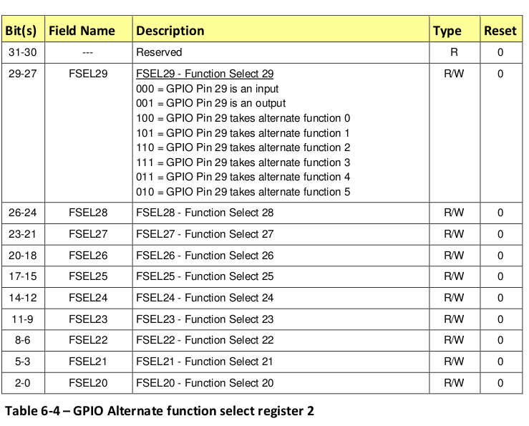
Configure the pin either input/output
BareMetal programming for GPIO pins for raspberry pi

Slide 33
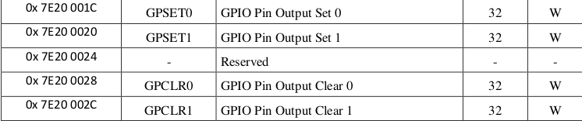
Addresses off set and clear registers:

Slide 34
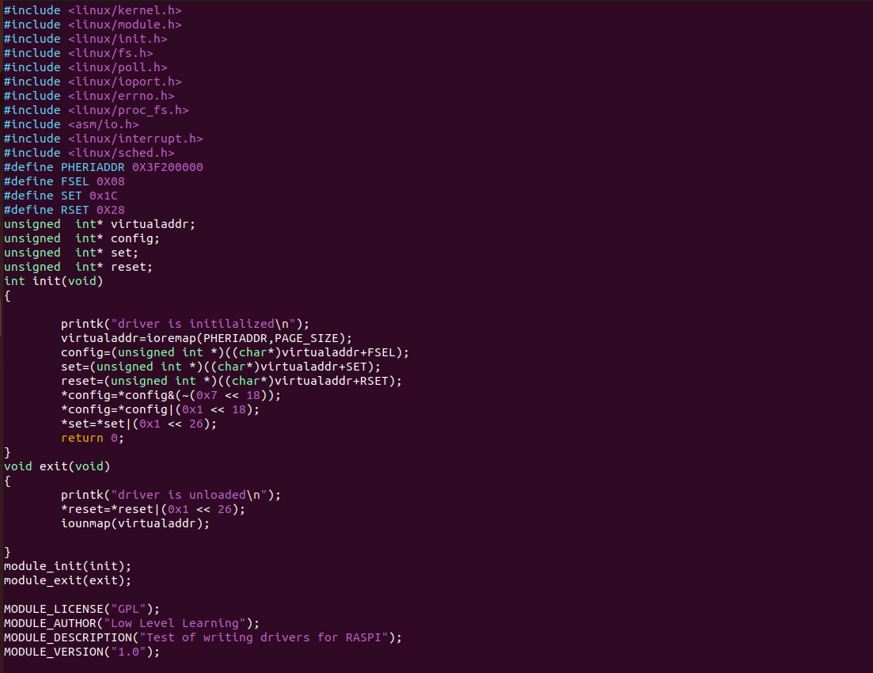

Slide 35
KERNEL TIMERS
What is a timer in general?
A timer is a specialized type of clock used for measuring specific time intervals.
There are two types of time:
1.Absolute time
2.Relative time
Absolute time :-
It is used to know the date & time of the day, we depend on hardware chip called real-time clock (RTC).

Slide 36
Relative time:
It is used to schedule the task or to create delays,from kernel point of view we call it as kernel timers.
Kernel timers are classified in to two different parts:
1. Standard timer
2. High resolution timer
Standard Timers:
These are measured in terms of jiffies.
Jiffies can be incremented from system bootup time.
Jiffies is defined in terms of constants called Hertz's,which is the number of times jiffies is incremented in one second.
If 1000 interrupts raises then it will be one jiffie.
These are declared in <linux/jiffies.h> header file.

Slide 37
To generate the delay in terms of milli seconds we will take the help of jiffies
Jiffies is a variable which is defined globally and can be accessed directly in any driver (we will have read only permissions).
The timer is represented by a kernel data structure struct timer_list which is defined in <linux/timer.h> header file
struct timer_list
{ unsigned long expires; void (*function)(unsigned long); unsigned long data; };

Slide 38
For initialization need to use this timer_setup function.
void timer_setup(timer, function, data);
Modifying Kernel Timer’s timeout
int mod_timer(struct timer_list * timer, unsigned long expires);
This function is used to modify a timer’s timeout.
This is a more efficient way to update the expires field of an active timer
(if the timer is inactive it will be activated)
The function returns whether it has modified a pending timer or not.
Return values:
0 – mod_timer of an inactive timer
1 – mod_timer of an active timer

Slide 39
Stop a Kernel Timer
The below functions will be used to deactivate the kernel timers.
int del_timer(struct timer_list * timer);
This will deactivate a timer.
This works on both active and inactive timers.
The function returns whether it has deactivated a pending timer or not.
Return values:
0 – del_timer of an inactive timer
1 – del_timer of an active timer

Slide 40
Check Kernel Timer status
int timer_pending(const struct timer_list * timer);
This will tell whether a given timer is currently running, or not.
Return values:
The function returns whether the timer is pending or not.
0 – timer is not pending
1 – timer is pending

Slide 41
High resolution timer
Kernel Timers are bound to jiffies. But this High resolution Timer (HRT) is bound with 64-bit nanoseconds resolution.
We need to include the <linux/hrtimer.h> in order to use kernel timers.
Kernel timers are described by the hrtimer structure
struct hrtimer { struct rb_node node; ktime_t expires; int (* function) (struct hrtimer *); struct hrtimer_base * base; };

Slide 42
Initialize High Resolution Timer
void hrtimer_init( struct hrtimer *timer, clockid_t clock_id, enum hrtimer_mode mode );
Start High Resolution Timer
Once a timer has been initialized, it can be started with the below-mentioned function.
int hrtimer_start(struct hrtimer *timer, ktime_t time, const enum hrtimer_mode mode);
This call is used to (Re)start an hrtimer on the current CPU.
Return values:
0 - on success
1 - when the timer was active

Slide 43
Stop High Resolution Timer
we can be able to stop the High Resolution Timer
int hrtimer_cancel(struct hrtimer * timer);
This will cancel a timer and wait for the handler to finish.
Return:
0 when the timer was not active
1 when the timer was active
Check High Resolution Timer’s status
The below-explained functions are used to get the status and timings.
ktime_t hrtimer_get_remaining(const struct hrtimer * timer);
Return :Returns the remaining time.

Slide 44
Thank you

